Slide 1
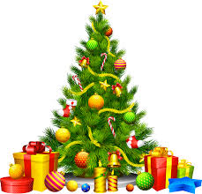
English Christmas

Slide 2
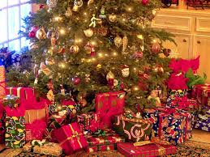
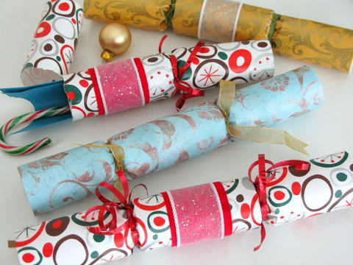
Present - Crackers

Slide 3
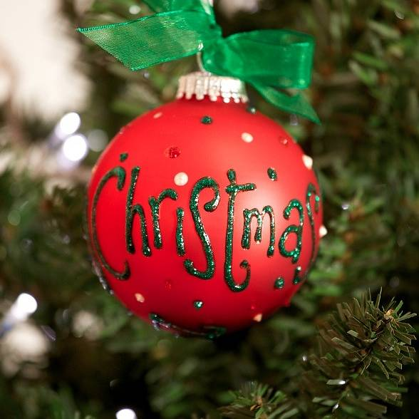
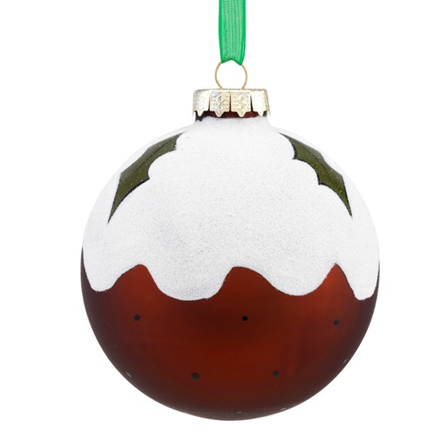
Bauble

Slide 4

Candle

Slide 5

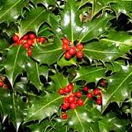
Holly

Slide 6

Wreath

Slide 7

Fireplace

Slide 8

Father Christmas

Slide 9
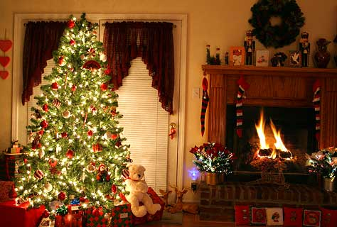
Christmas tree

Slide 10
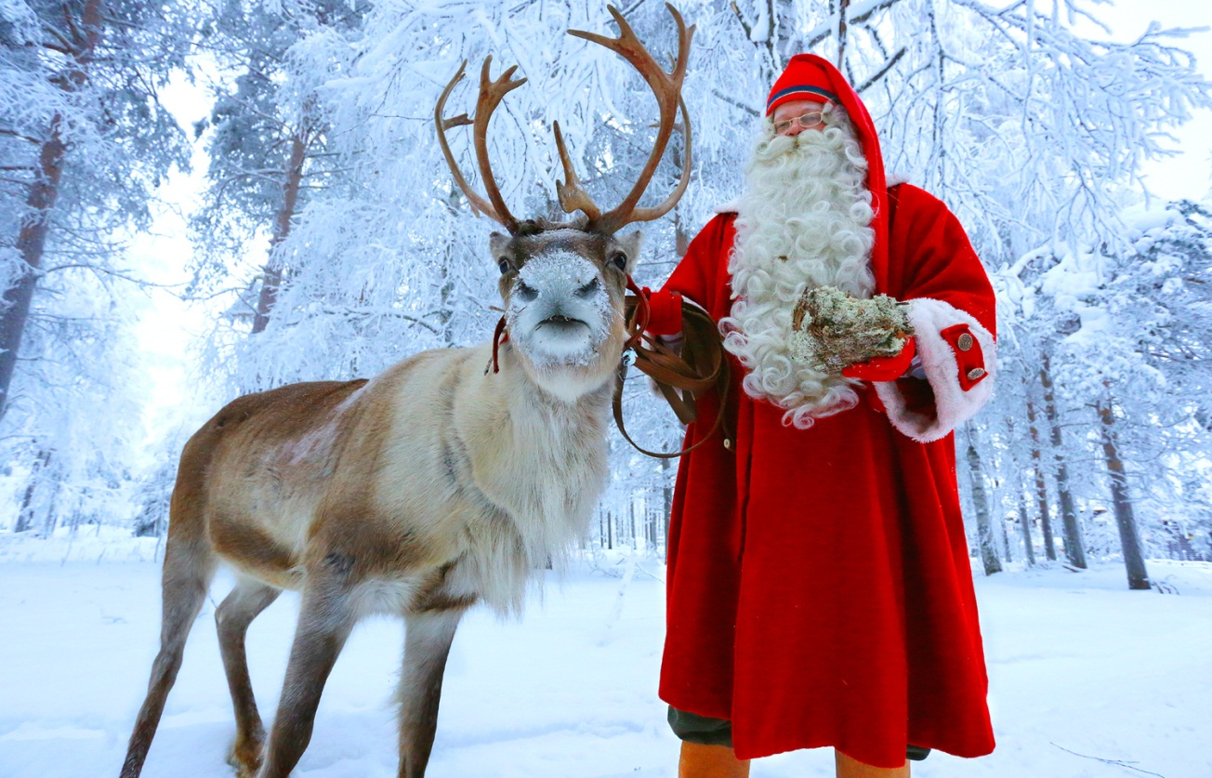
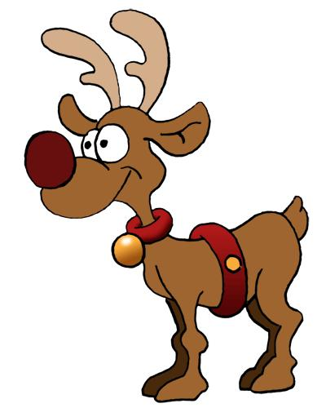
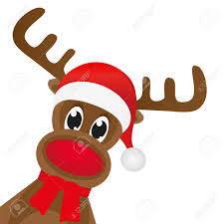
Reindeer Rudolph the Red-Nosed Reindeer

Slide 11

Lights

Slide 12
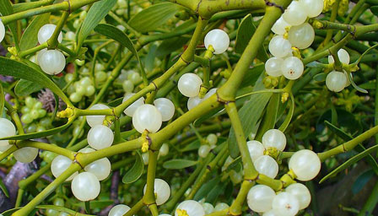

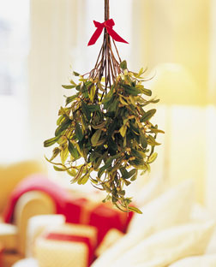
Mistletoe

Slide 13

Toys

Slide 14
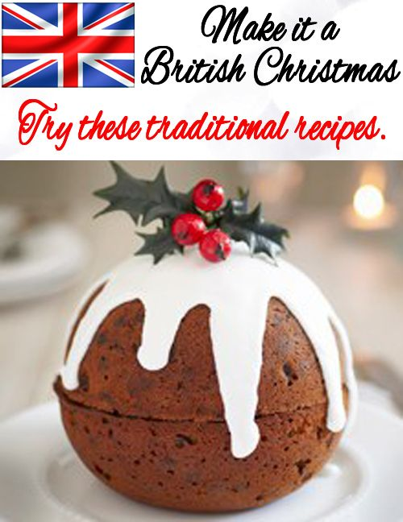
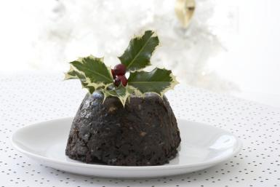
Christmas pudding

Slide 15

Bow

Slide 16
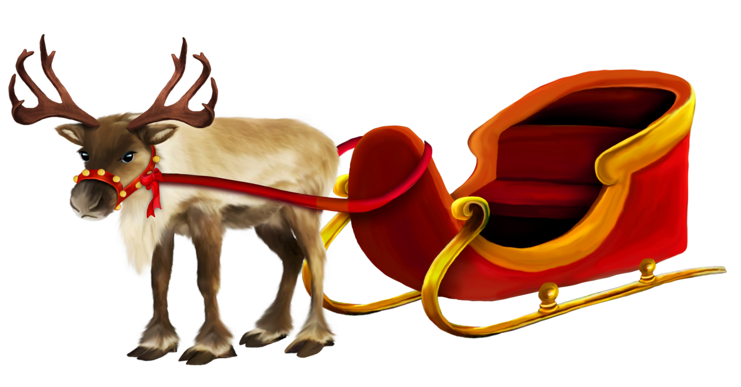
Sleigh

Slide 17
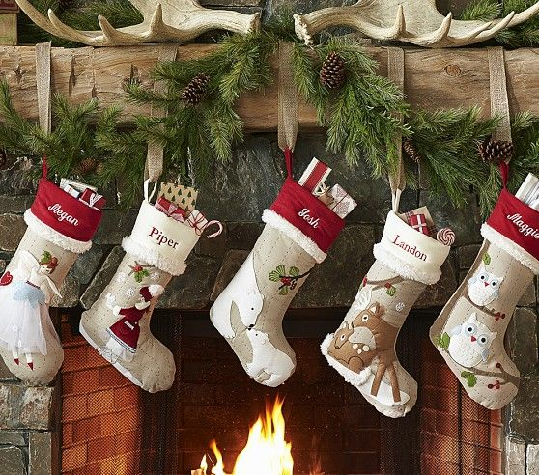
Christmas Eve 24th December

Slide 18
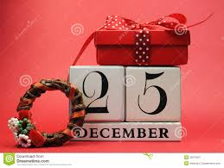
Christmas Day 25th December

Slide 19
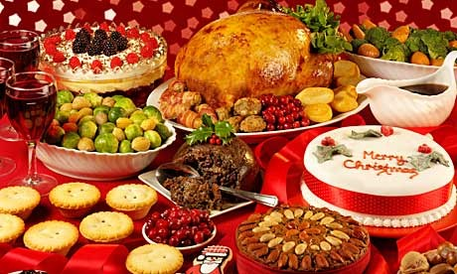
Roast turkey, roast vegetables, brussel sprouts, carrots, stuffing, gravy, christmas pudding...

